Slide 1
Bridges
By
James Hurley&
Lee Byrne
4th Class
Seomra 13

Slide 2
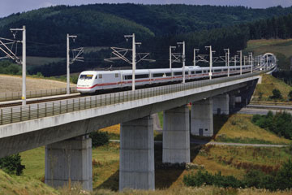
What are Bridges? Why do we Use bridges?
Bridges are built over roads, railway lines, vallies,bays, ravines and rivers
We use bridges to connect one place to the other.

Slide 3
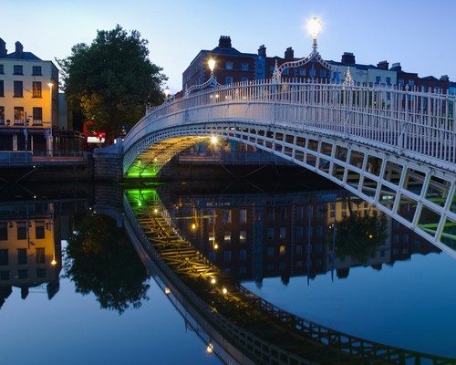
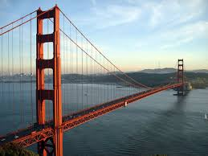
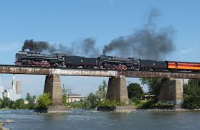
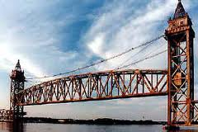
What kind of bridges are there
There are several types of bridges such as.
Arch bridge
Suspension bridge
Beam bridge
Truss bridge

Slide 4
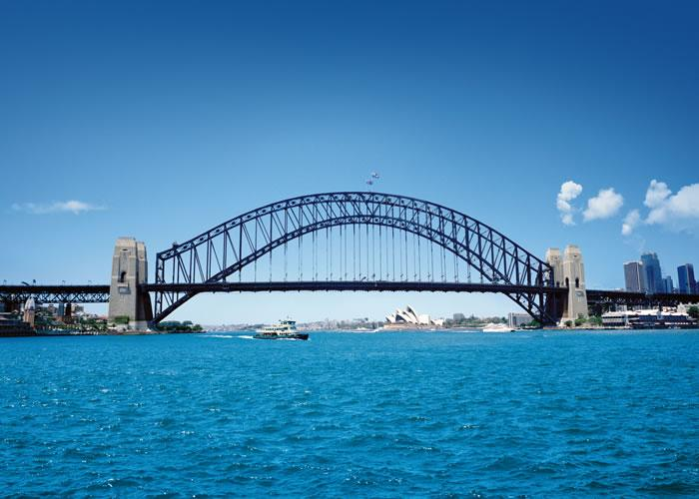
Arch bridges
Arch bridges can be supported by the bottom or the top.
Sydney harbour bridge has support on the top.
The arch makes the bridge stronger.

Slide 5
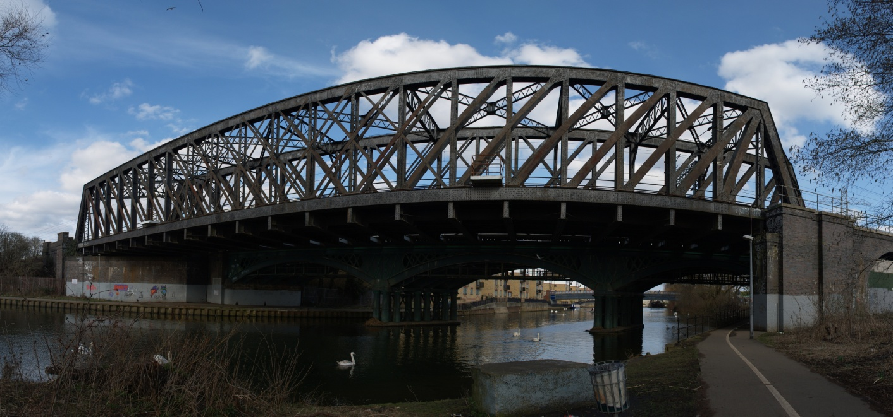
Truss bridge
Truss bridges is made by joining together lengths of steel into a framework.

Slide 6
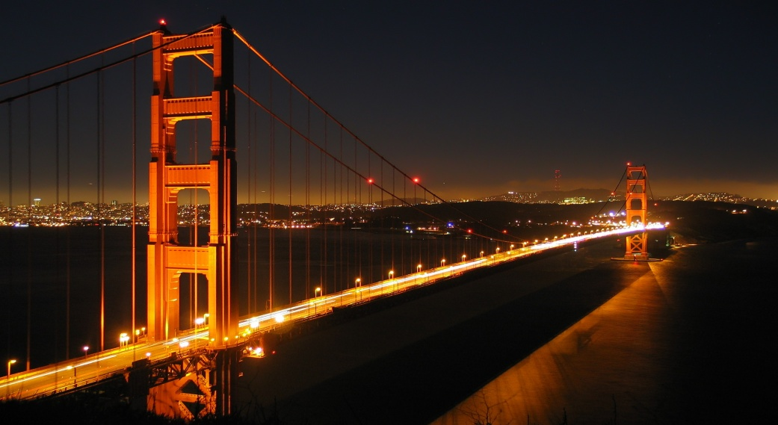
Suspension bridges
Suspension bridges have cables hanging down from the top.
There is a suspension bridge in San Francisco
at the pacific ocean.
It is called The Golden Gate bridge.

Slide 7
Beam bridges
The simplest type of bridge is very simple!It is just a BEAM supported at each end such as a tree trunk resting on each bank of a stream.

Slide 8
Famous bridges
There are lots of famous bridges around the world such as:
Golden Gate bridge in San Francisco America
Brooklyn bridge in Brooklyn America
Sydney harbour bridge in Sydney Ausraila
Akashi kaikyo also known as Perth bridge in japan

Slide 9
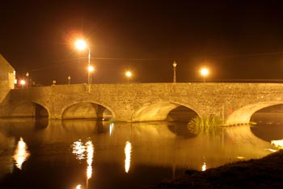
Bridges in your local area
Bridges that are in Ireland our local area such as
O connell bridge
The ha penny bridge
Wellington bridge
Burrin bridge
Millenium bridge

Slide 10
Intresting facts
The longest bridge span is akashi kaikyo also known as perth bridge with the length 1990m thats 2km without support
The Golden gate bridge is 1280m wide.It was completed in 1937.
Highest bridge royal gorge bridge colorado usa height a dizzing 321m above river level the empire state building could nearly fit underneath.
At 48.8m wide, Australias Sydney Harbour bridge is the worlds widest bridge.

