Slide 1
ENERGY
By Brigita, Aoife, Shane, Cillian, Conor
Seomra 13
Rang 4

Slide 2
What is energy?
Energy is the power of movement.
Energy gives you the abilty to do things eg. run, eat, read even sleep.
Many machines require energy to work.
Energy is produced by non-renewable and renewable sources of fuel.

Slide 3
Non-Renewable energy
Non-Renewable energy is energy that can’t be used again.
They are called fossil fuels eg.coal, oil, peat and gas.
Peat is a thick brown layer of decayed plants and animals.
It is found in a bog,
It is found in a wet marshy area.
Oil is a thick , black liquid that is found below the ground.

Slide 4
Renewable energy
Renewable energy can be used again.
Renewable energy comes from the wind, sun and water.
The wind can make your hair stand on end, blow papers out of your hand and even knock down trees.
We get energy and heat from the sun.
We can gather the energy from the sun to heat our homes.
Energy from water is called hydropower.

Slide 5
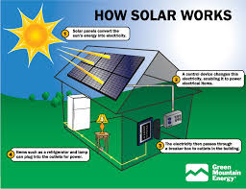
Solar Energy
We get energy and heat from the sun.
We can gather the energy from the sun to heat our homes.
The panels collect energy from the sun’s rays as they shine down on Earth.
This energy is used to heat our homes and power electricity.
Scientists hope that someday we will have solar powered cars.
Solar panels come in all shapes and sizes.
Lots of homes in Ireland have solar panels.
Have you ever noticed solar calculators, houses or road signs?

Slide 6
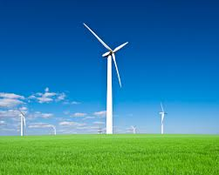
Wind Energy
For hundreds of years ,people have used windmills to collect power from the wind.
Nowadays wind turbines are used to make electricity.
A turbine is a bit like a wheel.
The wind turns the turbines and makes power.
You might have noticed turbines on hills and mountains.
Lots of wind turbines are placed together to make a wind farm.

Slide 7
Greenhouse effect
Greenhouse gases come from everyday activites such as heating our homes and using electricity.
As you know fossil fuels are often burned to make electricity, this releases carbon dioxide a greenhouse gas into the earth’s atmosphere.
People produce more carbon dioxide than any other type of greenhouse gas.
Carbon dioxide is responsible for most global warming.

Slide 8
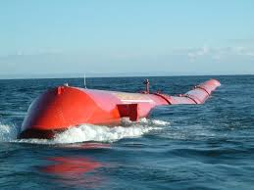
Wave Energy
Have you ever seen waves crashing onto the seashore or stood under a waterfall?
Hydropower can be used to create electricity .
There are diffrent types of hydropower .
A hydroelectric dam can be used to capture energy from moving water.
Energy can also be captured from waves by using special floating divcies .

Slide 9
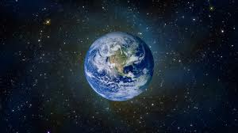
How can we save our planet
Unfortunately it is not possible to completely stop the greenhouse effect.
However there are things that you can do to help our planet.
Turn off water when you don’t need it.
Most people waste up to 5 liters of water every time they brush there teeth.
Walk or cicle to school rather than travel by car.
If you live in a town or city use the bus.

Slide 10
Interesting facts
Greenland used to be green it is locatedin the antartic circle and much of it is covered by a huge sheet of ice.
A volcano can change the climate in an area .
Huge volcanic explosins create dust that blocks the sun
Many crops could not grow throuh out the world people starved .
Some scientists belive that it was climate change that killed the dinasosaus around 65 million years ago .

